Slide 1
Data Analysis Cont.
Emanuele Della Valle
Prof. @ Politecnico di Milano & Partner @ Quantia Consulting
Marco Balduini
Founder & CEO @ Quantia Consulting

Slide 2
Exploring flux
Custom Functions

Slide 3
Recall: What Is Flux?
Flux is a functional data scripting and query language
Written to be:
Useable: easy to learn
Readable: developers read more code than we write
Composable: developers can build onto the language
Testable: queries are code
Contributable: open source contributions matter
Shareable: developers read more code than we write

Slide 4
Applying functions to each raw
The map() function applies a function to each record in the input tables. The modified records are assigned to new tables based on he group key of the input table.
Example
from(bucket:"foo")
|> range(start: -1h)
|> filter(fn: (r) => r._measurement == "samples")
|> map(fn: (r) => ({ _value: r._value * r._value }))
|> filter(fn: (r) => r._value > 23.2)

Slide 5
Defining and using a costume function
Syntax
<<function name>> = (<<variable>>*) => <<implementation>>
Example
squared = (r) => r*r
from(bucket:"foo")
|> range(start: -1h)
|> filter(fn: (r) => r._measurement == "samples")
|> map(fn: (r) => ({ _value: squared(r._value)}))
|> filter(fn: (r) => r._value > 23.2)

Slide 6
Defining a costume pipe forwardable function
Syntax
<<function name>> = (tables=<-) => tables |> << implementation >>
Example
allSquared = (tables=<-) =>
tables => map(fn: (r) => squared(r._value))
from(bucket:"foo")
|> range(start: -1h)
|> filter(fn: (r) => r._measurement == "samples")
|> allSquared()
|> filter(fn: (r) => r._value > 23.2)

Slide 7

Let’s get dirty!
8

Slide 8
Continuous Linear Pizza Oven
Learning goals:
Map functions
Custom functions
s2
s1

Slide 9
Task
Extract the measurements from the cooking base area and correct them by subtracting a delta of 5°C to each value
Use an inline map
Create a costume function to be used in the inline map
Create a costume function that contains a map

Slide 10
Take home message
Flux is extensible exploiting map() and the custom functions
The r with clause in a map keep the original row structure
A custom function can work on multiple lines or on each line of a table
The `<-` pipe-receive expression allows the function to capture the input tables

Slide 11
Exploring flux
Joining time series

Slide 12

Joining two time series

Slide 13
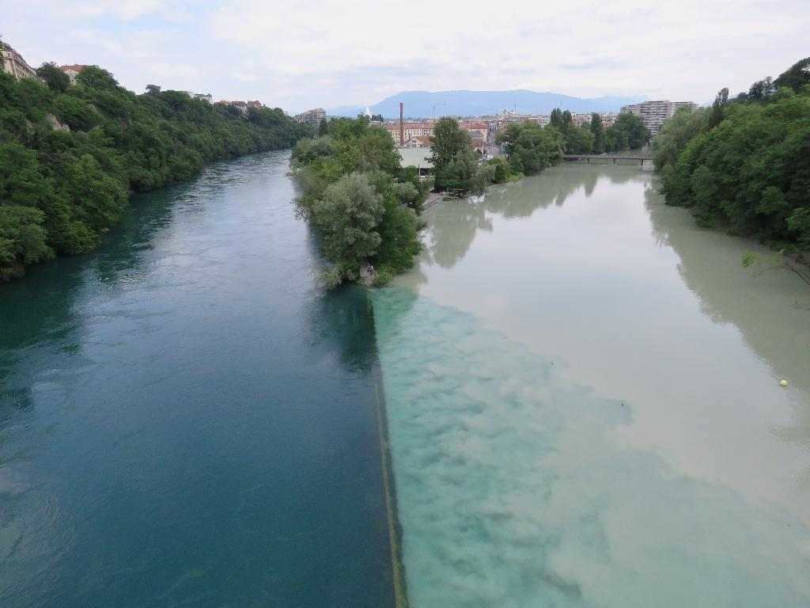
The ideal case

Slide 14
The easy case
305
290
285
S1
280
280
00:00
01:00
02:00
03:00
04:00
120
105
110
S2
100
95
00:00
01:00
02:00
03:00
04:00
S1-S2
185
185
185
185
170
00:00
01:00
02:00
03:00
04:00

Slide 15
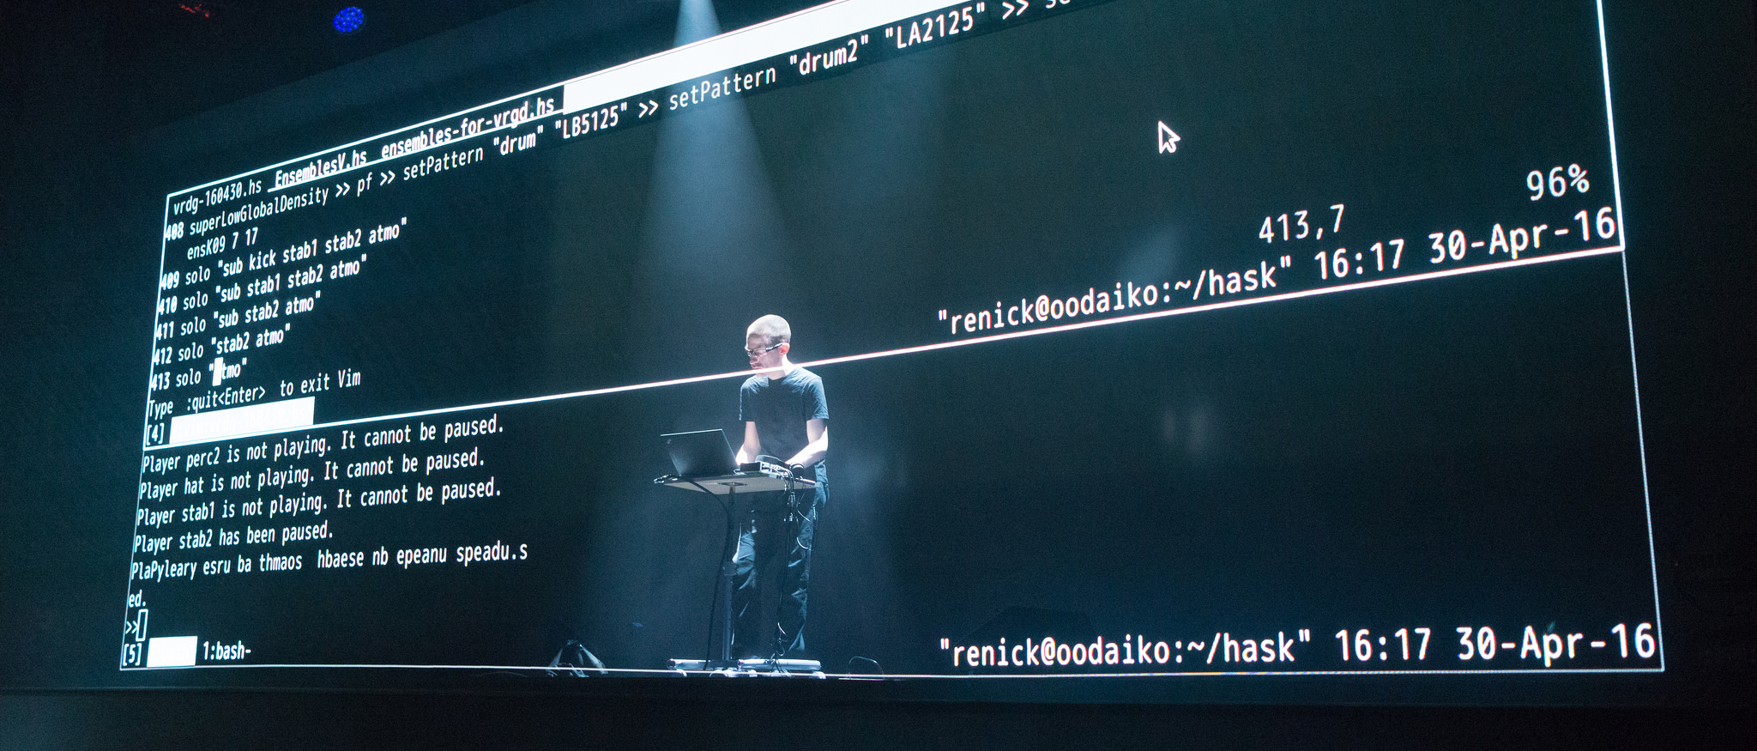
Let’s do some live coding

Slide 16
Here we go
temp = from(bucket: "training")
|> range(start: 2019-10-01T00:00:00Z, stop: 2019-10-01T00:05:00Z)
|> filter(fn: (r) => r._measurement == "iot-oven")
|> filter(fn: (r) => r._field == "temperature")
tempS1 = temp |> filter(fn: (r) => r.sensor == "S1")
tempS2 = temp |> filter(fn: (r) => r.sensor == "S2")
join = join( tables: {s1:tempS1, s2: tempS2}, on: ["_time"] )
join |> map(fn: (r) => ({ _time: r._time,
_tempDiff: r._value_s1 - r._value_s2 }))

Slide 17
It does not work with our data … why?
:-/

Slide 18

The reality is always more difficult than expected

Slide 19
A close look to the distribution of our data over time
305
290
285
S1
280
280
00:00
01:00
02:00
03:00
04:00
120
105
110
S2
100
95
00:15
01:15
02:15
03:15
04:15
NOTE: S1 metrics are not synchronized with S2 ones

Slide 20
Let’s discuss about alternatives and code them in flux
Join on time approximating
assuming a fixed delta → timeShift()
assuming a maximum error → trucateTimeColumn()
minimizing assumptions → aggregateWindow()

Slide 21
Let’s get more dirty!
9

Slide 22
Continuous Linear Pizza Oven
Learning goals:
Join data
s2
s1

Slide 23
Task
Extract the difference between the humidity levels of the base cooking area and the mozzarella melting area. Find if the differences are lower than 20% and greater than 30%

Slide 24
Take home message
Data From different time series can be joined on time
In few cases, you can use the exact join
In general, you need to manipulate data before joining them
Time shift data
Truncate time column
Aggregate over (synchronized) windows

